Slide 1
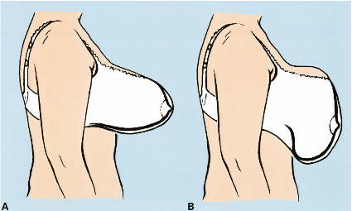
Bra Slide: Inadequate support of the lower part of the breast

